Slide 1
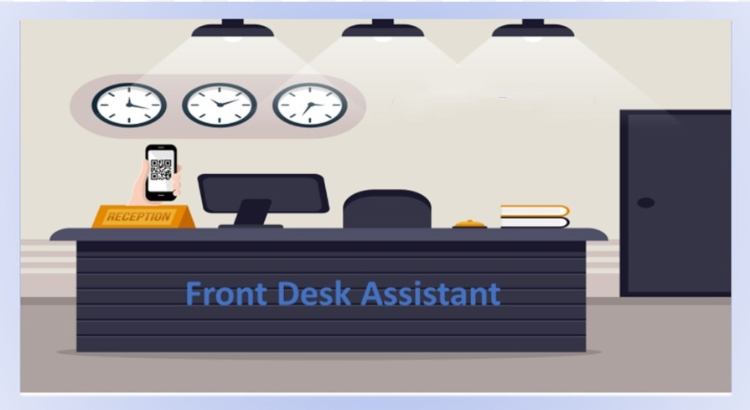

Slide 2
Project Description
In order to store the information of the visitor faster and without error.
This project aims at smartly storing and updating the visitor’s details. This is achieved by extracting details from the Aadhar Card.
The proposed Smart FDA will take care of the registration of the visitor’s details at the time of their visit. This system is for recording the visitors’ log. When a visitor visits the organization, number of their visits will be updated accordingly.

Slide 3
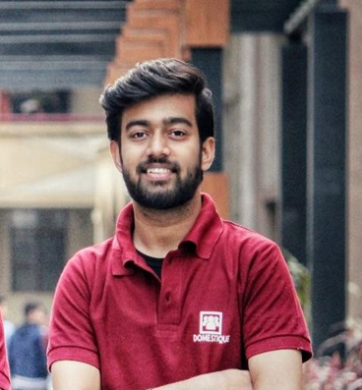
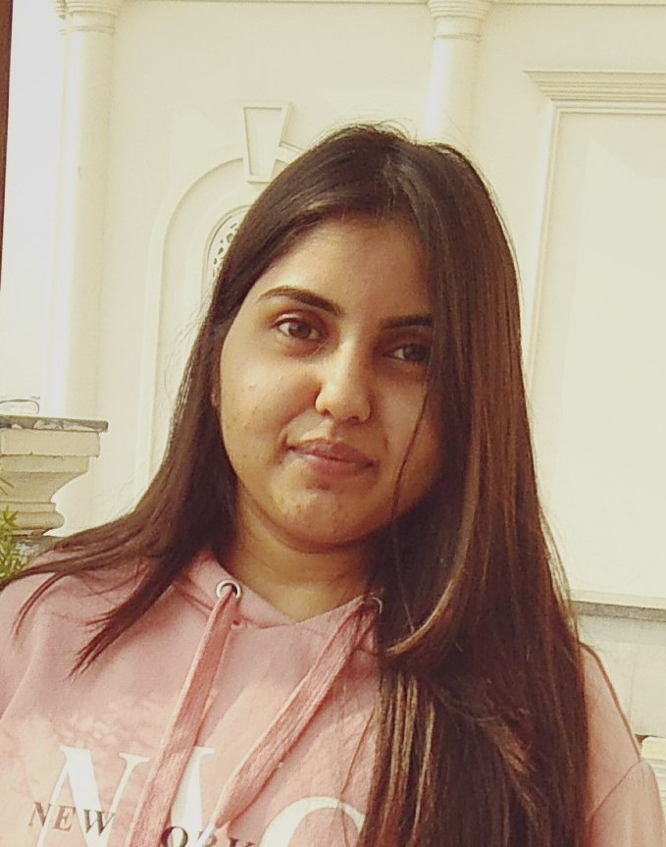
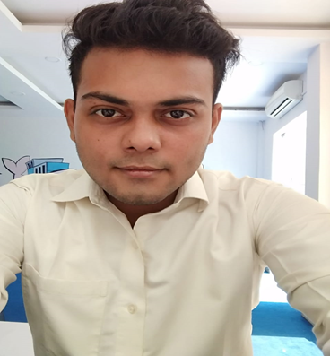
Our Team
Ritik Verma
Saumya Rastogi
Shivam Ranjan Pandey
Ritik Verma
Saumya Rastogi
Shivam R. Pandey

Slide 4
Saumya Rastogi
Worked as Android Developer
Developed an Android Application that is used to scan the QR code of Aadhaar card and seamlessly fetching the genuine and error free details of the person.
Posting of received data to the server using retrofit.
Technology used: Kotlin, Android studio.

Slide 5
Ritik Verma
Worked as Full Stack Developer
Worked on part which handles receiving of data from server (sent via app) and securely posting it to the registration form for prefilling.
A REST Api was used to get and post data of scanned image.
UI part of FDA and Admin part.
Used: Django Rest Framework, Front End Technologies: HTML, CSS, JavaScript.

Slide 6
Shivam Ranjan Pandey
Worked as Full Stack Developer
Worked on backend of FDA and Admin features which includes creation of new receptionist or admin , search for already visited user and generate reports of already visited user
Technology used: Django, Pymongo

Slide 7
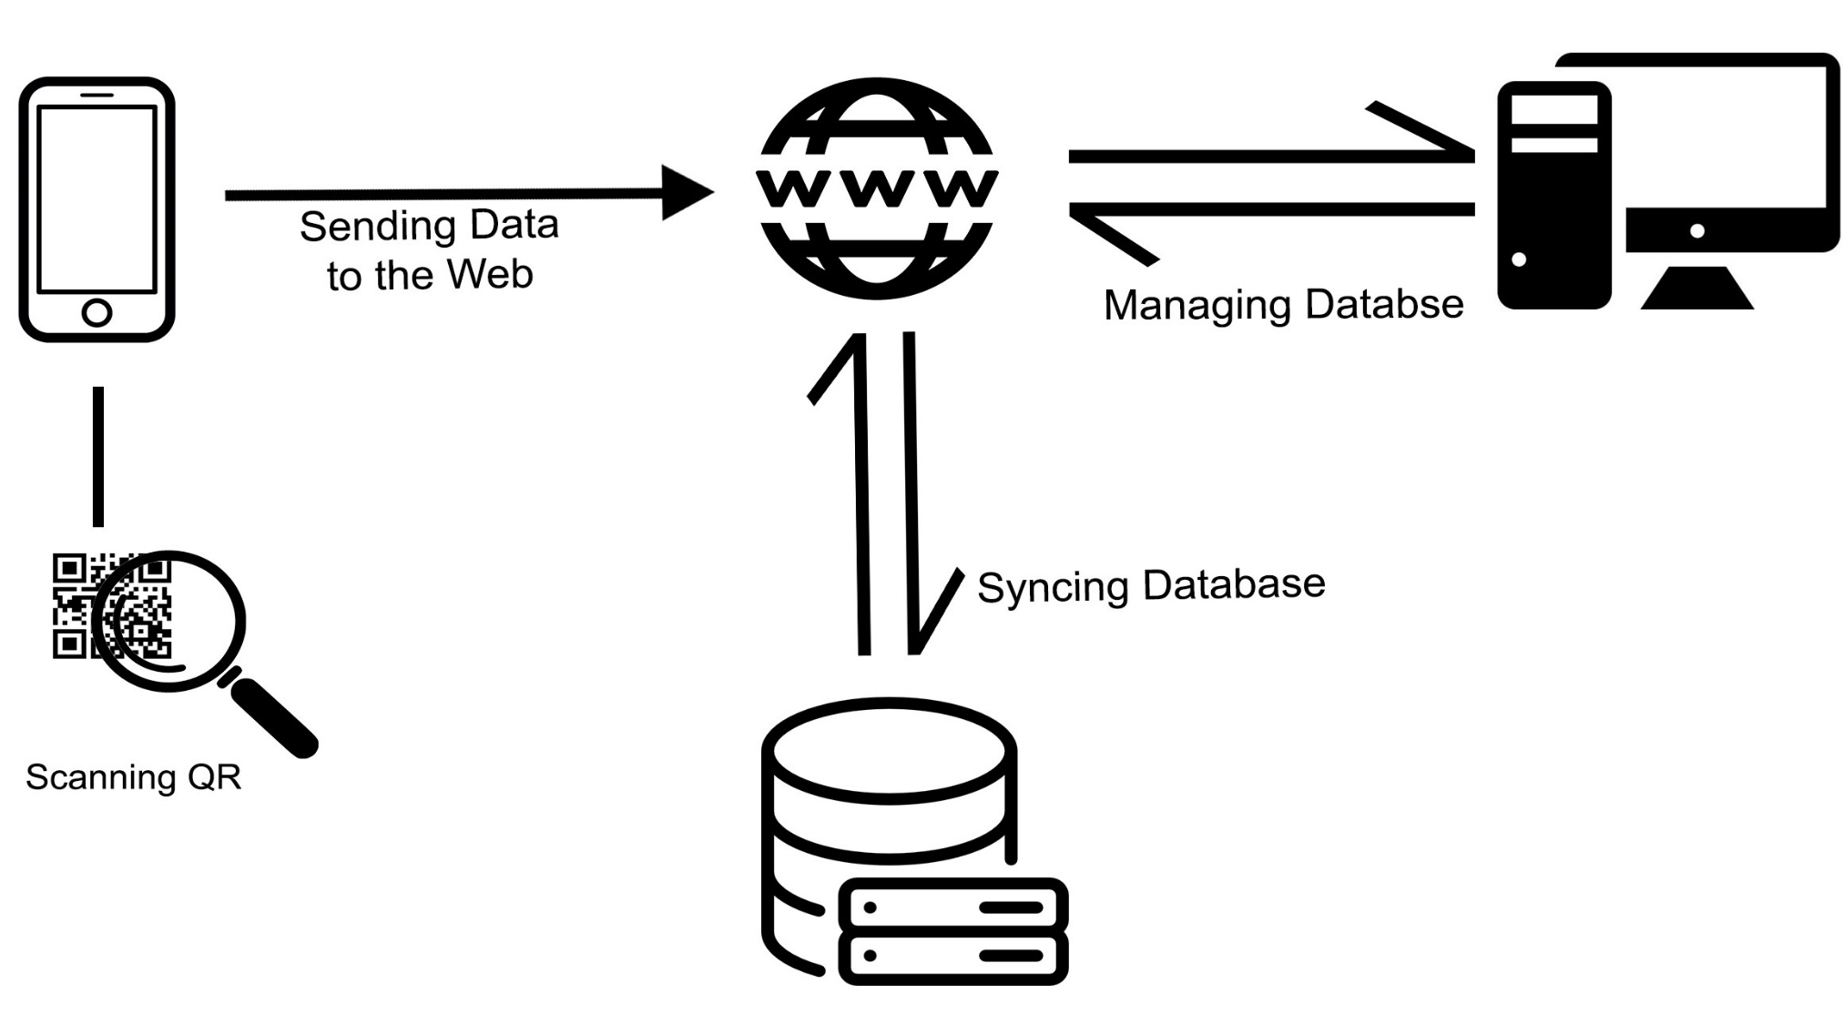
Architecture

Slide 8
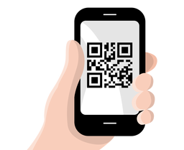
Android Application to Scan QR Code
Developed an android application, which will help in registering different kinds of visitors coming to an Institution.
Application will take recognized Government id i.e. Aadhaar card as input.
It will scan the QR given on Aadhaar Card and fetch the details required.
It will send the data to web server where it will be used to autofill the form.

Slide 9
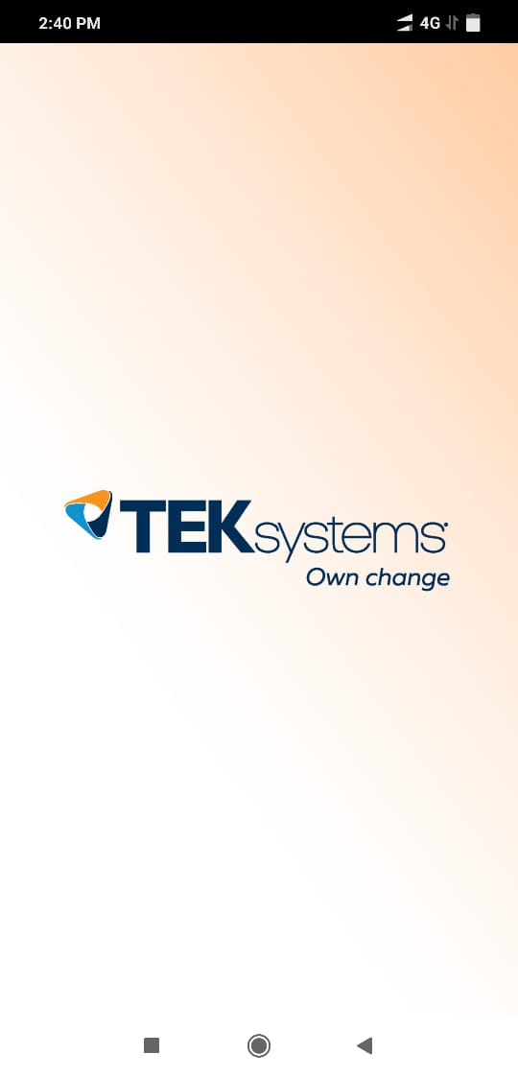
Working of Android application
On click of application icon, the first screen that a user will see while opening the app will be visible
It stays visible while the app is loading.

Slide 10
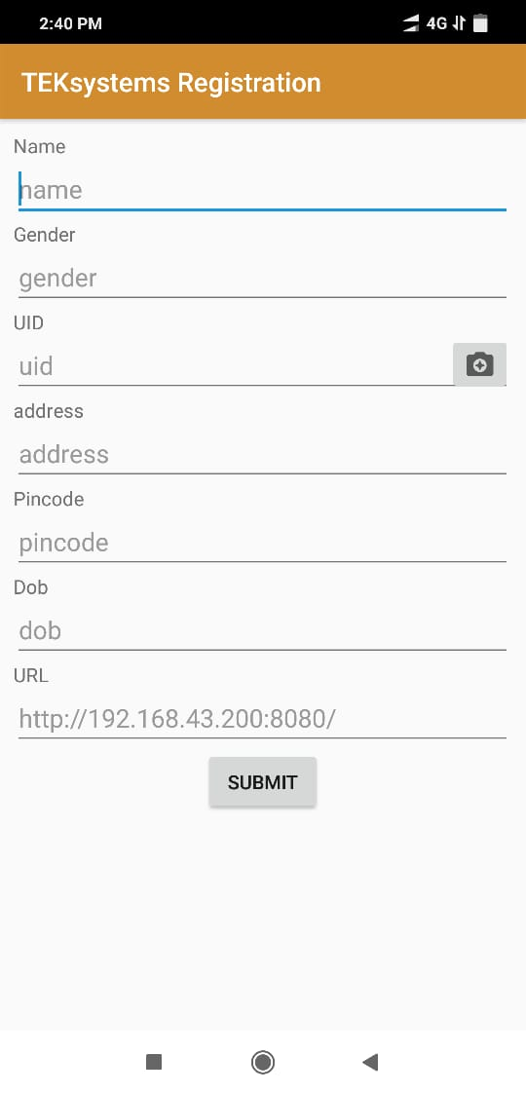
Registration:
This is the main activity in the android application it will show the details fetched from the Aadhaar Card.
There are seven fields:
Name
Gender
UID
Address
Pincode
DOB
URL

Slide 11
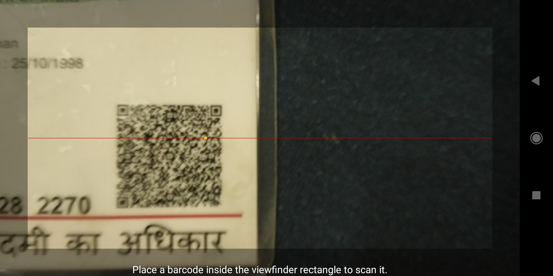
Scan QR:
On click of the camera icon, the QR Scanner will get active.
By placing Aadhaar Card inside viewfinder rectangle. It will scan the QR and fetch all the required details from Aadhaar card.

Slide 12
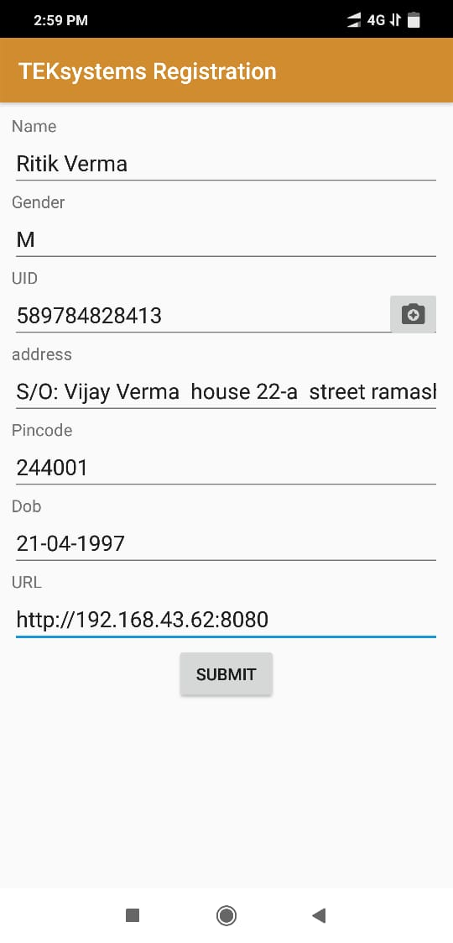
Fetching Details:
After fetching details from Aadhaar Card it will send the data in json format to the mentioned server url.
It will autofill the fields like Name, Gender, UID, Address, Pincode, DOB in the UI.

Slide 13

API Used:
ZXing (“zebra crossing”) is a barcode image processing library.
It has support for 1D product, 1D industrial, and 2D barcodes.

Slide 14
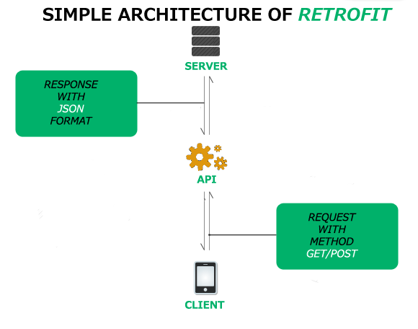
Retrofit:
Retrofit is a type-safe HTTP client for Android.
Retrofit makes it easy to consume JSON or XML data which is parsed into Plain Old Java Objects (POJOs).

Slide 15
Front Desk Web Application

Slide 16
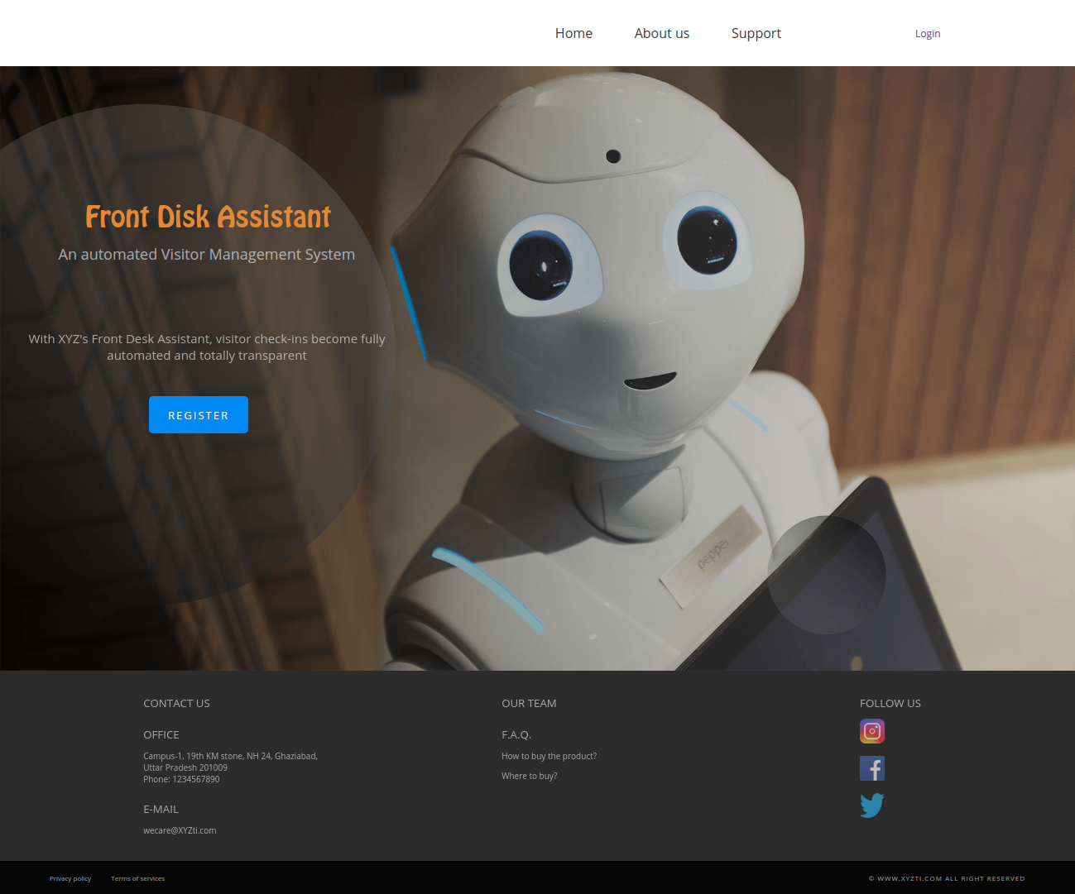
Home Page

Slide 17
We have many buttons in the home page for e.g., Register, About us, support, login etc.
We will discuss them further one by one.
Firstly, from this home page when we click on Register button, it will direct to receptionist login page.
Receptionist have to login before doing any registration of any visitor.
After login receptionist dashboard will appear.

Slide 18
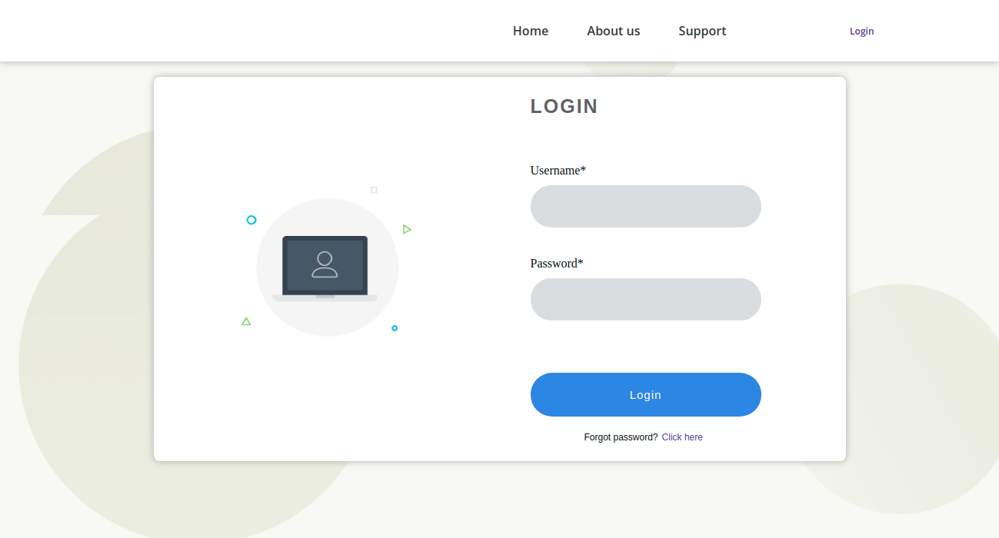
Receptionist Login

Slide 19
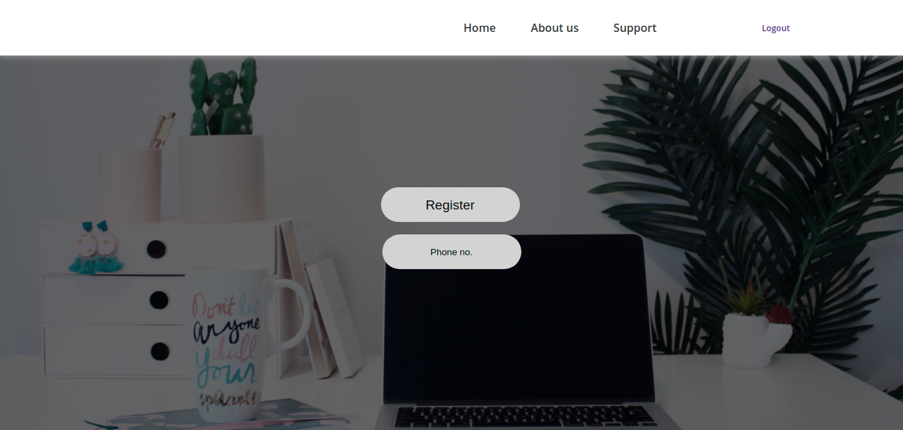
Receptionist Dashboard

Slide 20
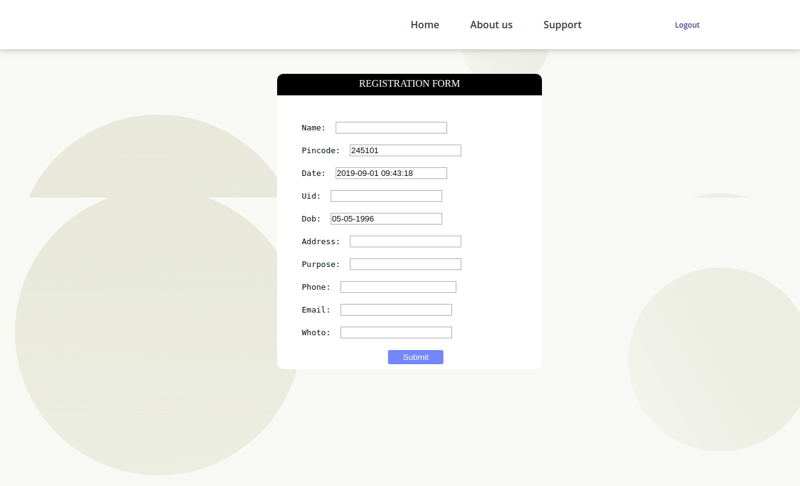
Registration Form (for the new visitor)

Slide 21
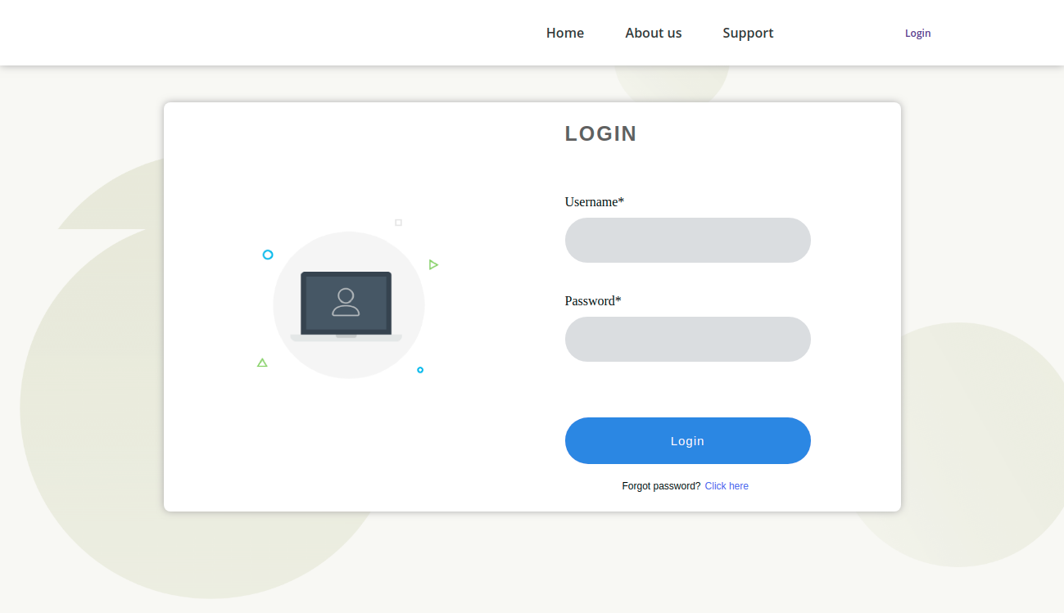
Admin Login

Slide 22
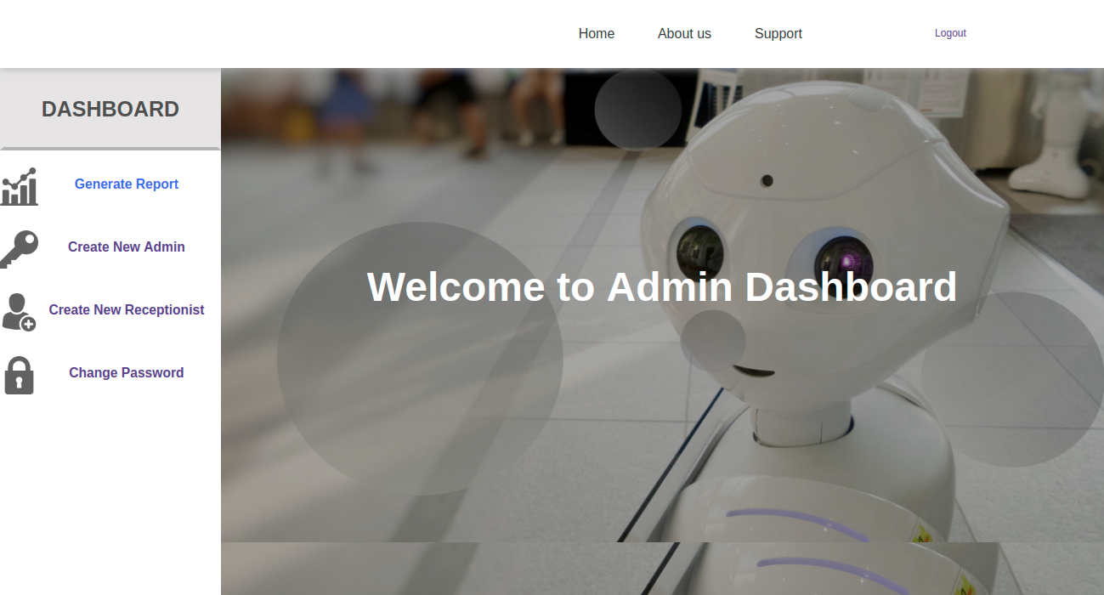
Admin Dashboard

Slide 23
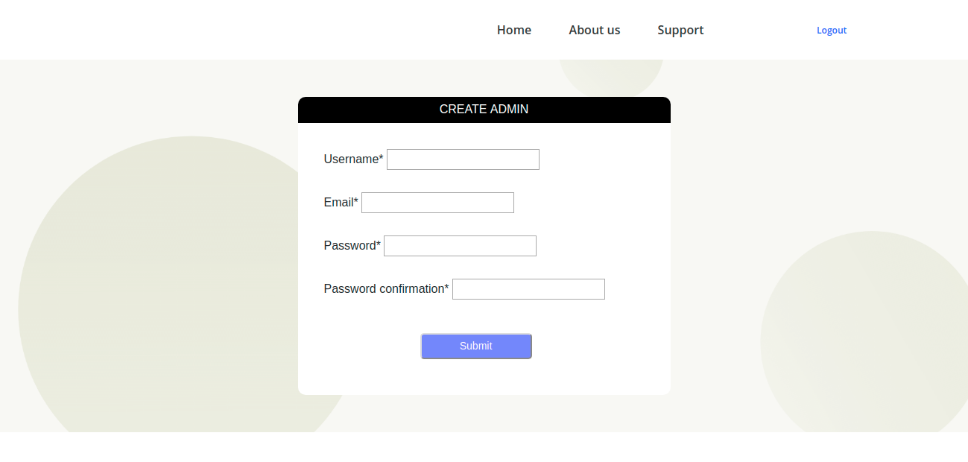
Create Admin

Slide 24
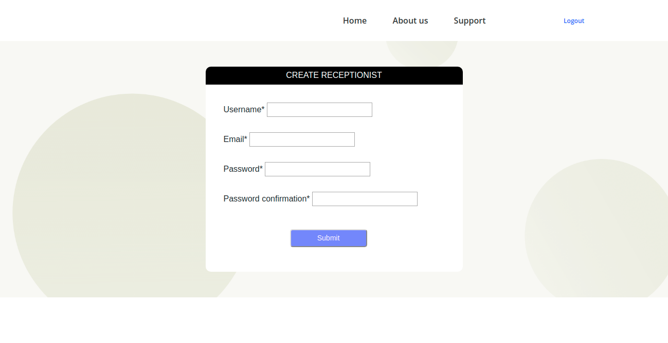
Create Receptionist

Slide 25
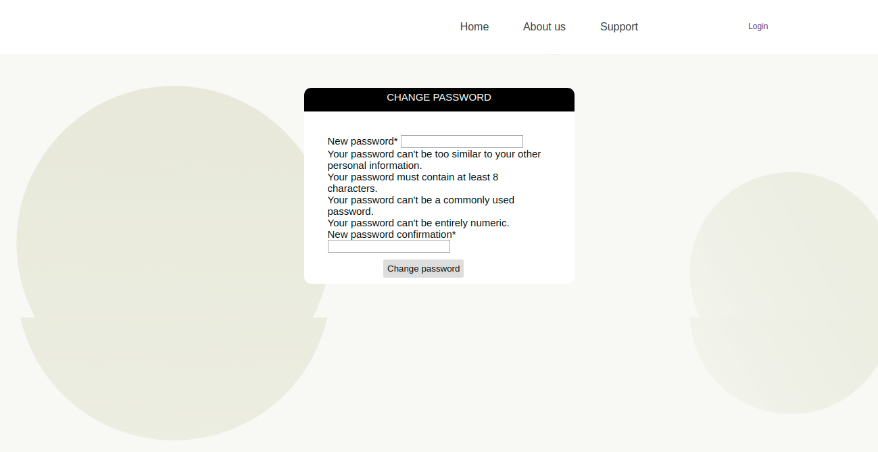
Change Password

Slide 26
Challenges Faced:
We faced challenges while integrating all the modules of the application.
We learnt communication skills and team work.
We learnt how to resolve conflicts between the team members.
We have to be very precise and clear while making the data-flow.
We need to think about all the possible situations and test cases that can occur while working with the software.
We learnt how to complete task within the given deadline.

Slide 27
Thank You

